Slide 1
3. Cohesion: A text analysis

Slide 2
Analysis of cohesion in a feature article
A form of news story but not so timely
Must contain all the Ws
Hung on a “peg” (i.e. a reason for writing it) : something that is happening today, this week or this month
Factual but includes also comment, analysis and ‘colour’
Conclusion: essential, wraps the whole piece up or refers back, in some way, to something mentioned right at the start

Slide 3
Elements of cohesion: Lexical cohesion
The internet is killing newspapers and giving birth to a new sort of news business
trimming
pared down
laid off
crisis
suffering
doing badly
thinning
dwindling
lump
killing
death
destroy
Closure
Shut down
Disappear
Synonyms
Collocations
Notes:
(topic continuity)

Slide 4
Elements of cohesion: Lexical cohesion
The internet is killing newspapers and giving birth to a new sort of news business
New …
Start
Unveiled
Latest update
future
Flourish
proliferating
Enriches
Enhance
encourage

Slide 5
Cohesion: grammar dependency
The internet is killing newspapers and (is) giving birth to a new sort of news business
Grammar dependency at phrase level
Ellipsis

Slide 6
Cohesion: grammar dependency
Tense and aspect
past | present | future
…founded in 1865 …used to enjoy … claimed to have seen some news | …is killing …is giving birth …are suffering …things are worst …have shut down … | …won’t even notice …will be different …will not be dominat-ed by few big titles …will be shaped by thousands of different voices

Slide 7
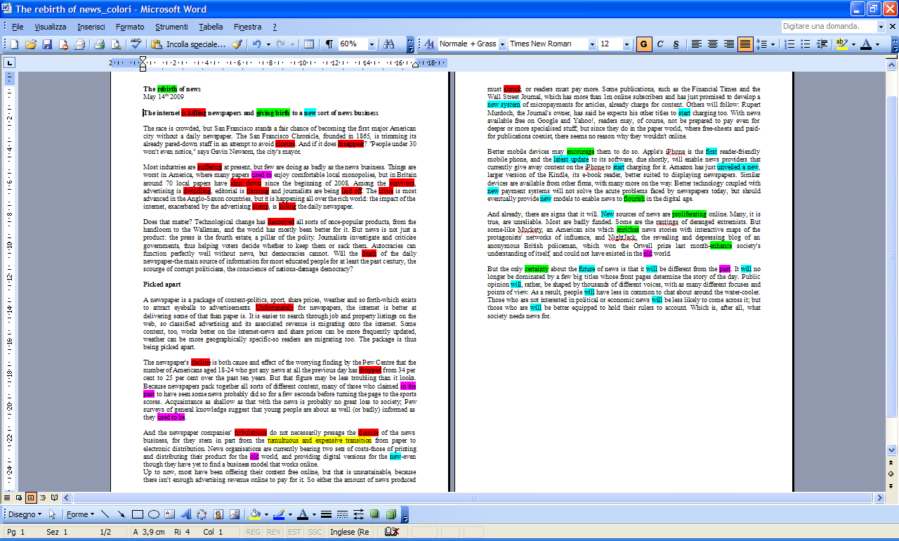

Slide 8
Cohesion/Coherence
Intro
  Peg: San Francisco Chronicle
  Crisis of newspapers (due to the impact of the Internet and the advertising slump)
  Leading question: Can the newspaper crisis have detrimental effects on decmocratic societies?
The body
  Reasons for the crisis of newspapers
    Many people turn to the web for contents/services previously provided by newspapers (e.g. job and property listings- classified advertisement)
    Advertising revenue migrating to the web
  Future perspectives:
    going electronic + charging for content
      New technological affordances (i-phones)
      New payment system (micropayment for articles)
    Ggeater plurality of sources
Conclusion
  Newspapers may die, but news will have a new start online

Slide 9
Other cohesive devices
The race is crowded, but San Francisco stands a fair chance of becoming the first major American city without a daily newspaper.
Most industries are suffering at present, but few are doing as badly as the news business.
Hyponymy
Notes:
Let’s go back to the beginning al look more closely at the introduction and the conclusion, to illustrate other startegies going beyond lexicon used to …

Slide 10
Other cohesive devices
The race is crowded, but San Francisco stands a fair chance of becoming the first major American city without a daily newspaper. The San Francisco Chronicle, founded in 1865, is trimming its already pared-down staff in an attempt to avoid closure. And if it does disappear?
  Collocation
  Cataphor
  Marked structure
  Typical of news language (Mainguenau: 2007): suspense creation
Notes:
Delay the discosure of reference

Slide 11
Other cohesion devices (reference)
Most industries are suffering at present, but few are doing as badly as the news business. Things are worst in America, where many papers used to enjoy comfortable local monopolies, but in Britain around 70 local papers have shut down since the beginning of 2008. Among the survivors, advertising is dwindling, editorial is thinning and journalists are being laid off. The crisis is most advanced in the Anglo-Saxon countries, but it is happening all over the rich world: the impact of the internet, exacerbated by the advertising slump, is killing the daily newspaper.
Anaphoric encapsulation is a cohesive device by which a noun phrase functions as a resumptive paraphrase for a preceding portion of a text.

Slide 12
Other cohesive devices
Most industries are suffering at present, but few are doing as badly as the news business.
  Ellipsis

Slide 13
Other cohesive devices
But the only certainty about the future of news is that it will be different from the past. It will no longer be dominated by a few big titles whose front pages determine the story of the day. Public opinion will, rather, be shaped by thousands of different voices, with as many different focuses and points of view. As a result, people will have less in common to chat about around the water-cooler. Those who are not interested in political or economic news will be less likely to come across it; but those who are will be better equipped to hold their rulers to account. Which is, after all, what society needs news for.
Comparative reference

Slide 14
Other cohesive devices
Among the survivors, advertising is dwindling, editorial is thinning and journalists are being laid off.
A newspaper is a package of content-politics, sport, share prices, weather and so forth-which exists to attract eyeballs to advertisements. Unfortunately for newspapers, the internet is better at delivering some of that than paper is. It is easier to search through job and property listings on the web, so classified advertising and its associated revenue is migrating onto the internet. Some content, too, works better on the internet-news and share prices can be more frequently updated, weather can be more geographically specific - so readers are migrating too. The package is thus being picked apart.
Parallelism at clause level
Parallelism at sentence level

Slide 15
Thematic structure
Sentence 1
Theme: The race
Rheme: is crowded, but San Francisco stands a fair chance of becoming the first major American city without a DAILY NEWSPAPER (= NEW information)
Sentence 2
Theme: The San Francisco Chronicle (= GIVEN information)
Rheme: is trimming its already pared-down staff in an attempt to avoid closure.

