Slide 1
COM 3708
Assignment 03
Integrated Communication Campaign
PHASE 2: CREATE

Slide 2



How to earn 100 marks?

Slide 3

Bag them one by one

Slide 4
Mark allocations
In Tutorial Letter 101 (Pages 67 & 68) the mark allocation is provided in detail
For each activity instructions are provided – on how to answer the question – and what we expect (linked to the mark allocation)
The secret: Take each aspect and in a systematically and calculated manner “bag” the marks.

Slide 5
Sale time: we are giving marks away for free!!
Minimum criteria for technical and academic presentation of your work | Evaluation
1. The portfolio contains a personal declaration that it is your own work (see Tutorial Letter CMNALLE/301). 2. The Table of Contents corresponds with the numbering, headings and subheadings in the portfolio. The correct numbering system is used, not the alphabet, nor I, II, III, IV, nor (i), (ii), (iii). 3. All sources consulted are cited in the list of sources consulted, including newspapers, magazines, policy documents, tutorial letters, study guides, prescribed books, other study material and people you consulted. 4. The correct reference techniques are used in the portfolio and in the list of sources consulted and they are not numbered, (Consult Tutorial Letter CMNALLE/301 for the correct reference techniques.) 5. Any other aspects related to the technical and academic presentation of your assignment or portfolio, such as appropriate subject terminology, are used and your presentation does not contain language, spelling or typing errors; nor does your presentation contain personal types of address). | 2 2 2 2 2

Slide 6
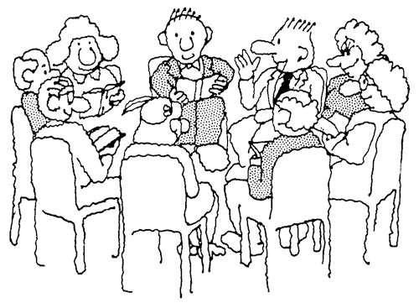
PHASE 2- CREATE
In the second phase
the campaign should be planned – based on the work that was done in the first phase.

Slide 7
2.1Stipulate the communication problem or opportunity
From the assessment document, the main communication problem or opportunity needs to be stated – as a communication objective.
This statement should satisfy the question on why the campaign is necessary and what it would achieve.

Slide 8
Answer the following questions:
    Formulate the main communication problem or opportunity for the organisation that you selected as the object for your campaign.
    Why do you need to do this campaign?
What does the campaign aim to achieve?

Slide 9
  2.2 Define strengths, weaknesses, opportunities and threats (SWOT analysis)
Before you can proceed with your SWOT analysis, you need to extract the following information form your research document:

Slide 10
INFORMATION (SWOT ANALYSIS)
    What information is obtained about the audience? Describe at least three audience characteristics that are relevant for the campaign –
    as discussed in activity 10.7 of the study guide.
    Define the needs of the audience.

Slide 11
BASED ON THE ABOVE, PROVIDE A SUMMARY OF THE FOLLOWING:
Strengths???
Weaknesses???
Opportunities???
Threats???
Problems???

Slide 12
2.3 Decide on the campaign topic
Formulate a one-sentence topic, describing your campaign:

Slide 13
Decide on a campaign topic
This is not about the organisation or the product/service/idea, but rather what exactly about these elements is going to be communicated in the campaign.
For example, a medical aid company could be doing a health awareness campaign, focusing on creating a “healthier you”. The campaign topic would then, for example, be worded as follows:
The “healthier you” campaign will promote health awareness and education amongst various stakeholders.

Slide 14
Formulate strategic communication objectives
When you conducted your research on the audience in phase 1, you were required to break down the main research problem into smaller researchable units, which were formulated as sub-problems. Similar to that, the formulation of strategic communication objectives requires you to draw on your campaign topic specified in the previous phase. Strategic communication objectives are made up of the following elements:
What the communication campaign is to achieve
The audiences among whom the objectives are to be attained
The degree to which the campaign achievements should be attained
The resultant behaviour or actions
The time-frame within which these are to be completed.

Slide 15
Examples of strategic communication objectives are the following:
To promote health awareness. using various media activities in order to get 35% of the medical aid scheme’s members living in South Africa to take part in the Virgin active gym-membership special, offered by the scheme in collaboration with said gym by December 2010.
To educate 50% of staff members at all branches via various communication programmes on the importance of maintaining a healthy balanced diet in the workplace by October 2010.
You need to identify and formulate at least three strategic communication objectives for your campaign.

Slide 16
Create the communication message

Slide 17
Formulate the “big idea” for your campaign in one sentence (2)
The “big idea” refers to what the message will communicate and is used to position the campaign in the minds of the audience.
The “big idea” relating to the campaign topic provided as an example is a healthier you, and is linked to the campaign topic of creating awareness and providing education on health-related issues with and amongst the various stakeholders of the organisation (the members of the medical aid scheme, the employees, etc).

Slide 18
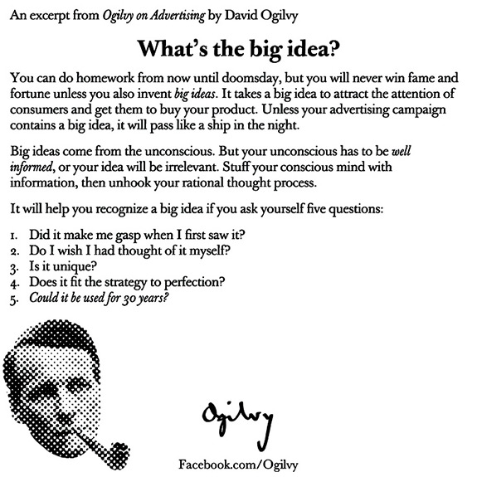

Slide 19
Remember to link all activities to the first phase. This should be based on the research you have done. Also take into account the characteristics of your audience that you have discovered in your research. You also have to consider how you would execute the message to reach your audience. Again, you have to rely on your research to guide you in this decision.

Slide 20
Formulate a message approach for your campaign (3)
You need to decide how to put the “big idea” into a format that can be easily communicated to the audience and that gets the intended message across. For this you need to consider the message approach that will work for the campaign and will ultimately be applied to the campaign.
The message approach is either a rational or emotional approach and is based on the information obtained about the audience and the organisation in phase 1.

Slide 21
A rational approach is used if the audience’s needs are functional, practical and informational. It is therefore very important to look back at the research conducted on the audience to determine which approach is more suitable for the message. With a rational approach, facts are used to address the audience.

Slide 22
An emotional approach is used when the audience’s needs are social or psychological (for example, esteem and social acceptance). Effective emotional approaches induce feelings such as satisfaction, pleasure, esteem or recognition.

Slide 23
Decide on how the message approach will be presented to the audience and list and discuss two ways in which this will be executed (4)
This exercise requires you to discuss the presentation of the message to the audience. It is important that you discuss how this execution will be applied to the campaign. A number of approaches to the execution of the message may be considered.

Slide 24
Examples are as follows:
Humorous
Factual
A demonstration
A testimonial
Fantasy
Personal recommendation
Remember to provide as much detailed information as possible when substantiating the execution.

Slide 25
Specify the mix of communication elements that will be used to implement the campaign (2)
The mix must be integrated and include elements characteristic of:
advertising
public relations and
online communication.

Slide 26
You must consider coordination and integration of communication elements in the communication mix. You must make sure that the elements are complementary and work towards meeting the specified objectives of the campaign. Make sure that you include a proper mix of media and techniques.

Slide 27
You have to apply the tools of advertising and public relations as well as the online communication tools. In an integrated communication campaign, these tools need to be integrated and applied alongside one another. Your selection of techniques will depend on the ""big idea'', the execution of the message and marrying this with the information you obtained from the assessment in phase 1 of the campaign.

Slide 28
Select the media

Slide 29
A major challenge in developing a communication campaign is to select the appropriate media. Using the mass media can be costly and therefore needs to be considered discriminately - are you sure that the costs can be justified? However, public relations tools, such as demonstrations, events, promotions, media relations and others, can be extremely cost-effective, but may not reach as widely as others. Online media also provide a wide audience at affordable costs, but audiences are highly defined and limited to a select group of people.

Slide 30
Provide a list of media: (4)
(at least four media activities) you would use to distribute your message. You need to select appropriate media for advertising, public relations and online communication.

Slide 31
For each medium identified, discuss why you selected that medium and how it will contribute to internal integration. When discussing internal integration, refer to the criteria of reach, frequency and impact. (8)
Reach refers to the total number of people exposed to the message (for example, number of media representatives present at a media launch or the estimated readership of a community newspaper). The greater the reach of the medium, the greater the number of people who will receive the message via the specified medium.

Slide 32
Frequency refers to the number of times an individual is exposed to the message sent via the specified medium. For example, some people may drive past a billboard every weekday on their way to work. The greater the frequency, the more exposure a recipient has to a message.

Slide 33
Impact refers to the strength of a medium in conveying the message sent, and in effect disseminating the message to the desired audience effectively. This refers not only to the medium selected, but also to the message sent. An excellent message will have greater impact than one that is merely mediocre.

Slide 34
Produce the communication material

Slide 35
Design four activities (4)
For the final activity, you need to provide all materials discussed in the previous section (Select the media). These need only be done in draft format of the various materials (such as press releases, advertisements, speeches, event programmes, websites, social media, banners, radio advertisements, as well as television advertisements).

Slide 36
Explain how each activity contributes to the “big idea” (4)
For each design, discuss how it would help convey the “big idea” (meaning intended) specified in the firsts section.

Slide 37
Proof of authenticity: Evaluation of the planning of the campaign by the organisation

Slide 38
Include an official letter from the organiser(s) (or the person at the organisation with whom you collaborated) in which the value of the campaign to the organisation and possible problems are discussed.
If you do not include this letter in the portfolio, your marks for this portfolio will be halved.

Slide 39
100 coins packed in a bag

Slide 40
Thank you very much for attending this live Hangout.
We hope you found this helpful
Please contact us should you have any queries
Again:
This was an experiment and we would like you to give us your feedback and critical views to allow us to improve and provide a better service.

