Slide 1
COM 3708
Assignment 03
Integrated Communication Campaign
40% of final mark

Slide 2
Student failure rates for portfolio assignment
Semester | Students failing | Students with less than 30%
2nd Semester 2014 | 110 | 47
1st Semester 2015 | 92 | 42
2nd Semester 2015 | 72 | 33
1st Semester 2016 | 76 | 40
https://sites.google.com/groveis.com/com3708/

Slide 3



How to earn 100 marks?

Slide 4

Bag them one by one

Slide 5
Mark allocations
In Tutorial Letter 101 (Pages 67 & 68) the mark allocation is provided in detail
For each activity instructions are provided – on how to answer the question – and what we expect (linked to the mark allocation)
The secret: Take each aspect and in a systematically and calculated manner “bag” the marks.

Slide 6
Sale time: we are giving marks away for free!!
Minimum criteria for technical and academic presentation of your work | Evaluation
1. The portfolio contains a personal declaration that it is your own work (see Tutorial Letter CMNALLE/301). 2. The Table of Contents corresponds with the numbering, headings and subheadings in the portfolio. The correct numbering system is used, not the alphabet, nor I, II, III, IV, nor (i), (ii), (iii). 3. All sources consulted are cited in the list of sources consulted, including newspapers, magazines, policy documents, tutorial letters, study guides, prescribed books, other study material and people you consulted. 4. The correct reference techniques are used in the portfolio and in the list of sources consulted and they are not numbered, (Consult Tutorial Letter CMNALLE/301 for the correct reference techniques.) 5. Any other aspects related to the technical and academic presentation of your assignment or portfolio, such as appropriate subject terminology, are used and your presentation does not contain language, spelling or typing errors; nor does your presentation contain personal types of address). | 2 2 2 2 2

Slide 7
10 coins in the bag!
Absolutely free!!!
…. 90 coins to go

Slide 8
Phase 1: Assess
Activity | Sub-activity | Marks
1.1 Identify the communicator | 1.1.1 Identify an organisation(s). 1.1.2 Write a letter to the organisation(s). 1.1.3 Write a report. | 1 2 2
Instruction 1.1.1: Identify an organisation or organisations that you will approach with the proposal to plan a communication campaign. Write down the name of the organisation(s) and its (their) contact details:
…. Another coin in the bag – only 89 to go

Slide 9
Instruction 1.1.2:
Write a letter to the owner/manager/organiser of the organisation in which you explain that you would like to meet him/her to propose the planning of a communication campaign – also explain what the campaign will entail. Explain that persons concerned will be under no obligation to implement the campaign and what the planning process will require. Remember, this first act of approaching the organisation is also an act of communication – convincing the organisation and its management that you can add value to the organisation (selling yourself and your expertise). Attach the letter as an appendix. Write a report covering the following:

Slide 10
You have bagged two coins by following the instruction!!!

Slide 11
You have now bagged 13 coins already!

Slide 12
Last two coins for Activity 1.1
Write a report:
What was your experience in approaching the organisation – did you experience it as positive or negative?
How did the organisation respond to your request?
You have to establish a working relationship with the organisation – what arrangements would you make? To whom would you report and who would be your contact person at the organisation? How often would you report back to the organisation? Write a brief report on how you established a working relationship with the organisation.
Identify who the communicator for the campaign would be. Would it be the organisation as a whole, a section of the organisation, etc? Substantiate your choice by explaining why the communicator has been designated as such.

Slide 13
You have just earned another 2 coins and bagged 15 coins – 85 to go

Slide 14
1.2 Identify the target audience
1.2 Identify the target audience | 1.2.1 Problem statement 1.2.2 Sub-problems 1.2.3 Research questions 1.2.4 Unit of analysis 1.2.5 Population(s) 1.2.6 Sampling procedures 1.2.7 Methodology and measuring instrument 1.2.8 Results 1.2.9 Audience segmentation 1.2.10 Self-reflection | 2 3 3 1 1 2 4 2 1 1

Slide 15
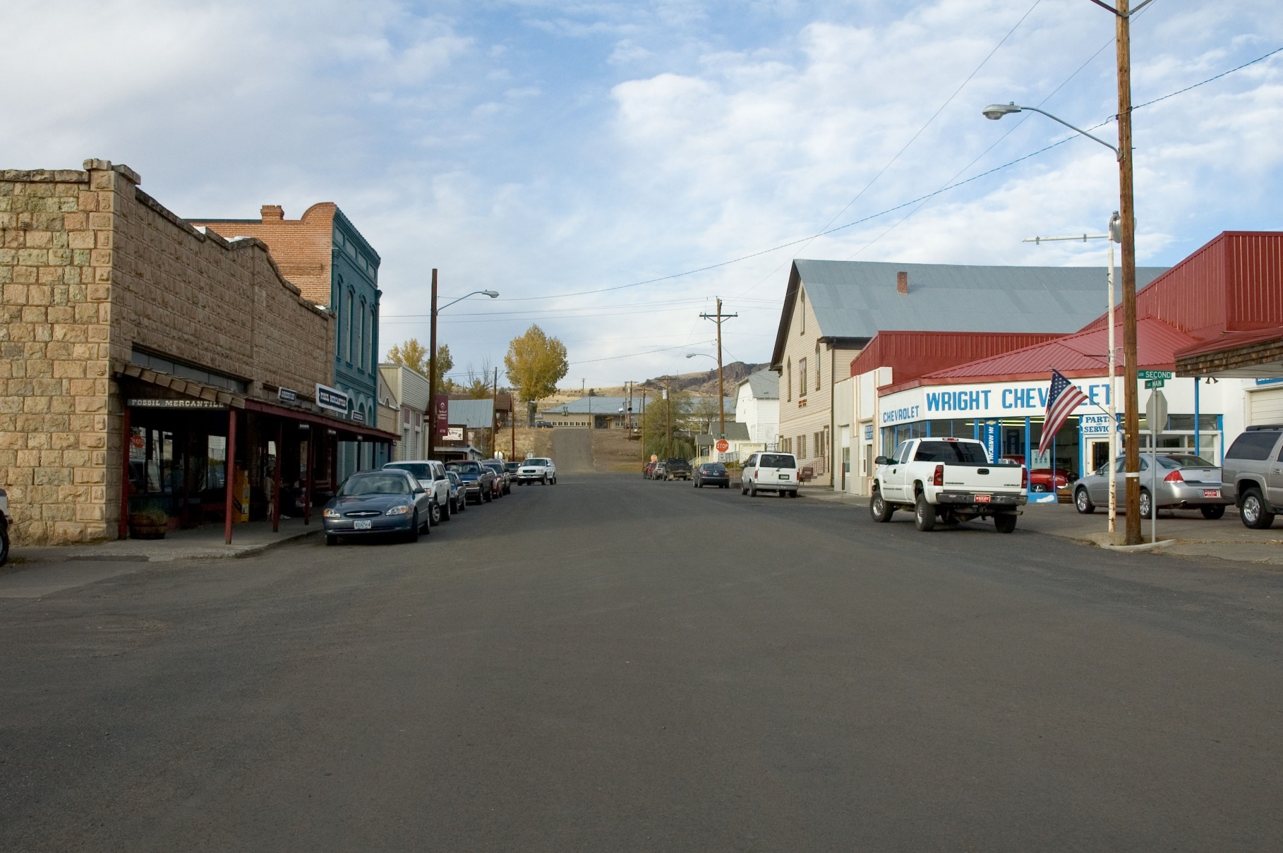
Why do we do research?

Slide 16
1.2.1 Instructions?
Formulate a brief problem statement for the research (remember that this should be a research problem statement – trying to collect the information to identify the real communication opportunities or problems).
On page 53 of Tutorial Letter 101 there is an extensive discussion with an example of how such a problem statement should be formulated (almost a template of what should be there or not)

Slide 17
How can you earn the two coins?
By following the instructions and come up with something like:
A quantitative evaluation of potential supporters’ levels of, and perceptions and attitudes towards the Hospice and its palliative care: a cross-sectional survey

Slide 18
You have just earned another 2 coins and bagged 17 coins – 83 to go

Slide 19
1.2.2 Formulate at least three subproblems (3 marks)
Subproblems must divide the main research problem into smaller researchable units. Taking one of the issues that come out of the main research problem. For example:
To establish current levels of awareness of the hospice amongst potential donors.

Slide 20
Second subproblem (taken from a student’s submission)
Explain the importance of funding and donations in terms of the functioning of the Hospice
Anything wrong with this???

Slide 21
You have just earned another 3 coins and bagged 20 coins – 80 to go

Slide 22
1.2.3 Formulate one research question for each subproblem
Purpose of the research question is to operationalise the subproblem. The example is given:
If the subproblem is: To establish current levels of awareness of the hospice amongst potential donors
Then the research question will be:
What are the current levels of awareness amongst the potential donors of the hospice?
Explain how this information will assist you to solve the main problem

Slide 23
You have just earned another 3 coins and bagged 23 coins – 77 to go

Slide 24
1.2.4 Identify the unit of analysis
The answer to this is effectively given in the instructions for answering this section on page 54 of Tutorial letter 101.
It says after explaining what the unit of analysis is that:
For example, if you are doing a survey or interviews, individuals will be your unit of analysis

Slide 25
You have just earned another 1 coin and bagged 24 coins – 76 to go
This one really was for free

Slide 26
1.2.5 Identify the population for the study (one mark)
The instructions for this can be found on page 54 of Tutorial letter 101.
It gives examples for small charities – explaining it can be the community / neighbourhood or region – such as Pretoria-East.
Can also be targeting churches in the city etc.

Slide 27
You have just earned another 1 coin and bagged 25 coins – 75 to go

Slide 28
1.2.6 Describe sampling procedures
(2 marks)
The instructions for this can be found on page 55 of Tutorial letter 101.
It gives examples for small charities – explaining it can be the community / neighbourhood or region – such as Pretoria-East.
Can also be targeting churches in the city etc.
If you focus on each aspect – you will do it correctly – and earn your coins.

Slide 29
You have just earned another 2 coins and bagged 27 coins – 73 to go

Slide 30
1.2.7 Identify methodology and describe how measuring instrument has been developed (4 marks)
Align measuring instrument with subproblems – can even use subproblems as sections of a questionnaire to ensure you probe every part of the main problem.
Focus on perceptions, attitudes, awareness, media preferences etc.

Slide 31
You have just earned another 4 coins and bagged 31 coins – 69 to go
You are now beyond those who got less than 30%

Slide 32
1.2.8 Report your results
(2 marks)
Instruction for results – either surveys or interviews are discussed in detail – with example of a frequency table
It is not enough only to report results – it also need to be discussed. You have to convince the reader by explaining the results and its implications for the project

Slide 33
How was it done by the student submission earlier?
Question 3: Do you need to belong to a certain religious group to use a hospice’s services? | Yes | No | Don’t Know
 | 3% | 65% | 32%
The response received on question 3 is indicative that the community does not know whether the Hospice only caters for patients belonging to a certain religion

Slide 34
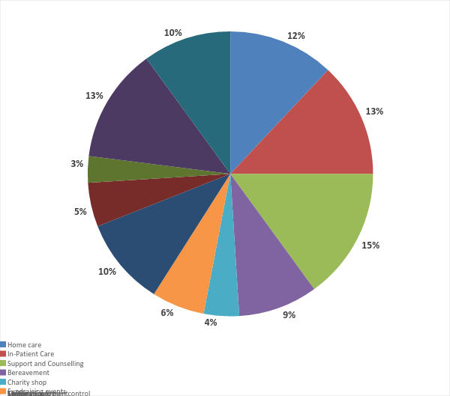

Slide 35
Respondents seem to be informed about some of the core-functions of the Hospice, but not all. Respondents are least aware of bereavement follow-up, specialised training provided to nurses and volunteers as well as the charity and coffee shops.

Slide 36
You have just earned another 2 coins and bagged 33 coins – 67 to go

Slide 37
1.2.9 Audience segmentation
(1 mark)
This is directly linked to the demographic section of the survey (for example).
Example in the instructions of how time available may be different for full-time working women against housewives. One group has more money to donate and the other can offer services.
If provided for in the measuring process – this one mark is a given.

Slide 38
You have just earned another 1 coin and bagged 34 coins – 66 to go

Slide 39
1.2.10 Self-evaluation on research section (1 mark)
Four questions are asked – and no answer can be wrong – purely based on your subjective views
If the four questions have been answered you will earn one point – without exception.

Slide 40
You have just earned another 1 coin and bagged 35 coins – 65 to go

Slide 41
100 coins packed in a bag

Slide 42
Thank you very much for attending this live Hangout.
This was an experiment and we would like you to give us your feedback and critical views to allow us to improve and provide a better service.

